Slide 1
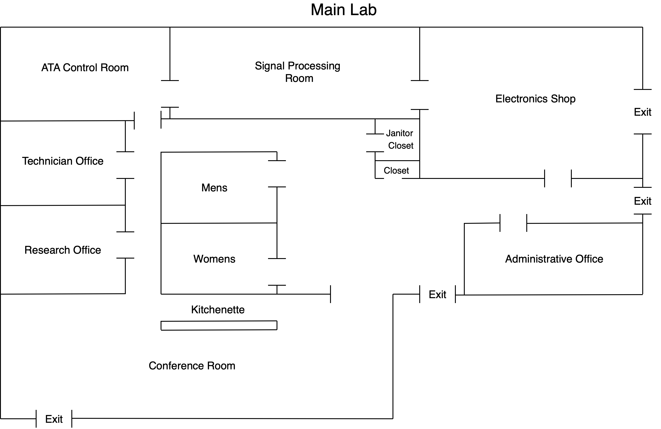

Slide 2
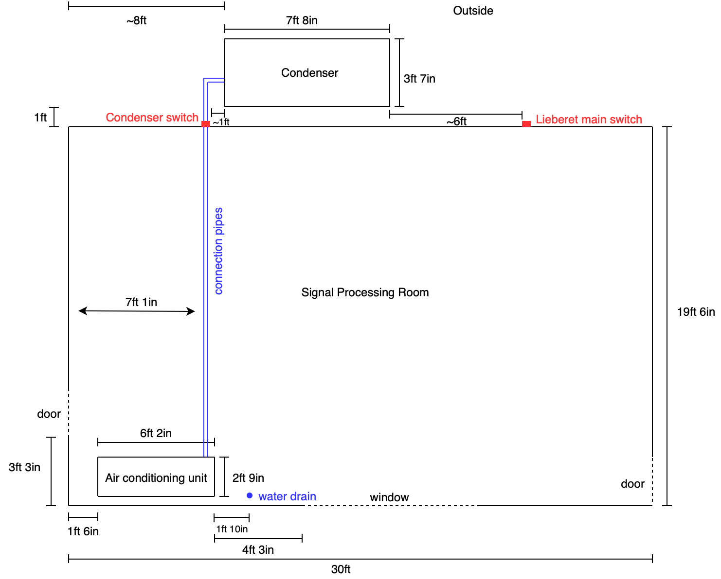

Slide 3
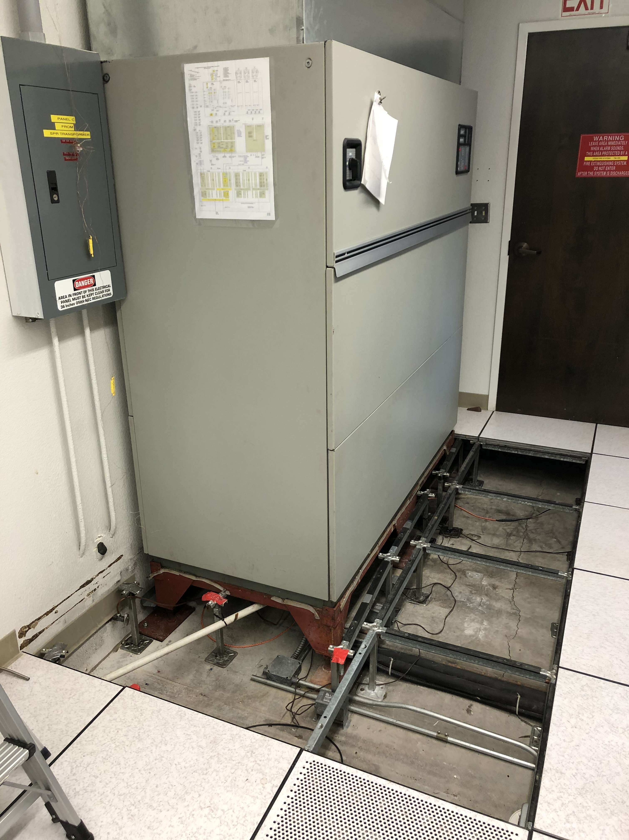
11inches between raised floor and cement foundation
Pipes that connect to the compressor outside
Pipe to water drain

Slide 4
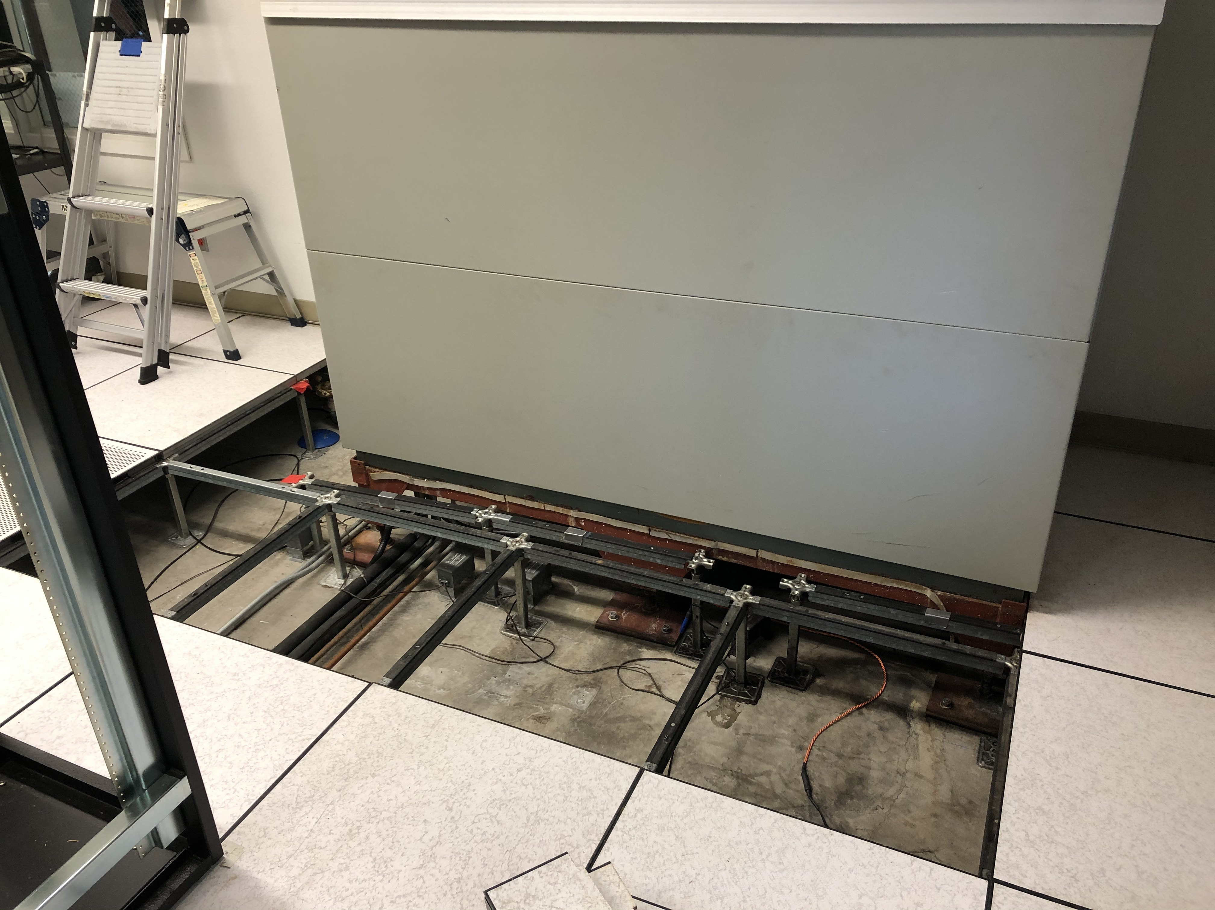
11in
Connector pipes

Slide 5
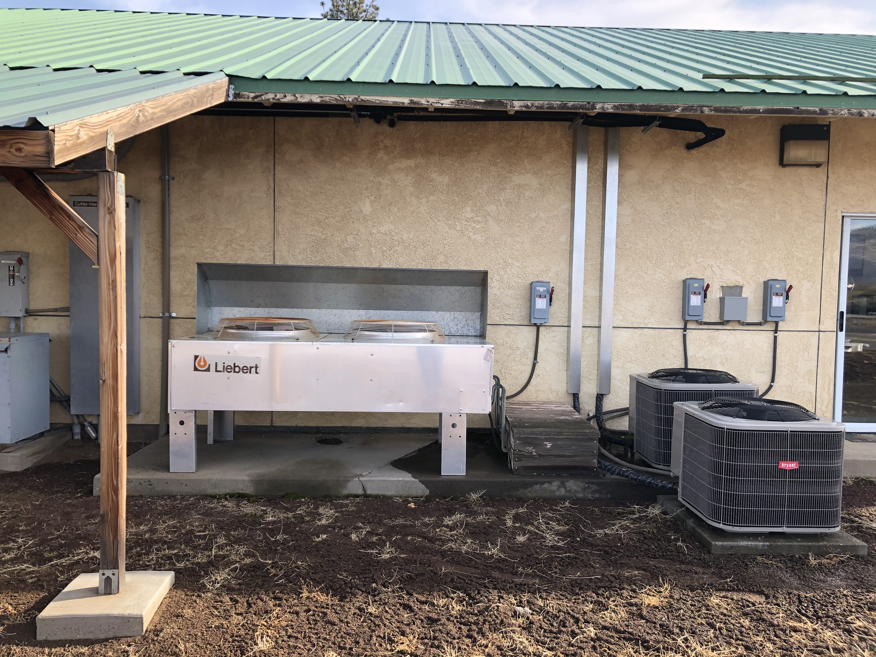
Condenser
Connector pipes contained within wood box

